Slide 1
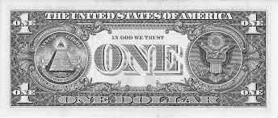
IMPACT OF RELIGIOUS FREEDOM on CORRUPTION
3.1.25
URC PRESENTATION
PRESENTER: Vilai ‘Ilolahia

Slide 2

Introduction
What is Religious Freedom?
Definition: Religious Freedom can be defined as the right for everyone to be able to practice their religion as well as set up and maintain religious institutions without government interference (Fox 2015).

Slide 3

Research Question
Research Question: Is there a relationship between Religious Freedom and Corruption? How much of an Impact does Religious Freedom have on Corruption?

Slide 4

Concepts and Perspectives
All the religions in the world encourage moral and ethical behavior. However, belonging to a religious group does not necessarily imply full obedience and practice of the teachings of that group (Gokcekus and Ekici 2019).

Slide 5

Correlation?
Empirical Evidence indicates that religiosity, rather than religious affiliation, impacts corruption levels. The more religious a society is, the higher the corruption, regardless of religious affiliation (Gokcekus and Ekici 2019).
Religious Freedom does not influence corruption but dominant religions in nations have influence over corruption in those nations (Chase 2010).

Slide 6
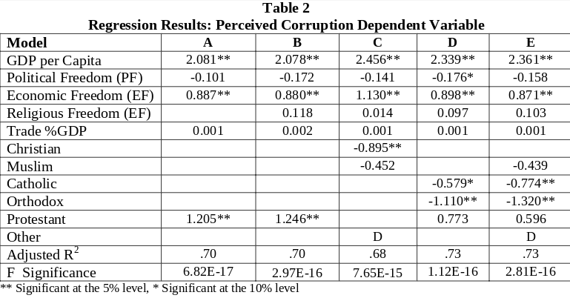
Data
(Chase 2010)
Measurement of Corruption: Percieved Corruption from Sandholtz and Koetzle’s Regression Model (2000)

Slide 7
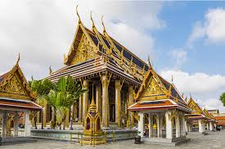
Religious Freedom in Asia
3 Main Situations
Religious Identity overlaps with race and ethnic identity.
Control of Religions by the centralized state.
Countries with clear secular and democratic base. (Wilfred 2016)

Slide 8
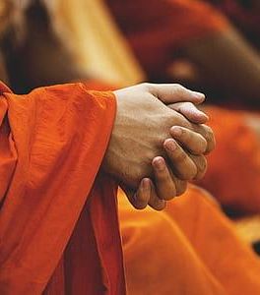
Conclusion/ So What?
Religious Freedom is a complex variable and is difficult to define. As we see in Asia, Religious Freedom unlike the Western theories, is defined by factors of race and ethnicities, control by state and countries with secular and democratic base.
Is Religious Freedom a Human Right that all enjoy, or does it depend? If it does depend on other factors, is it no longer a freedom for all?

