Slide 1
Peace and Justice in Cambodia
Joseph Sant

Slide 2
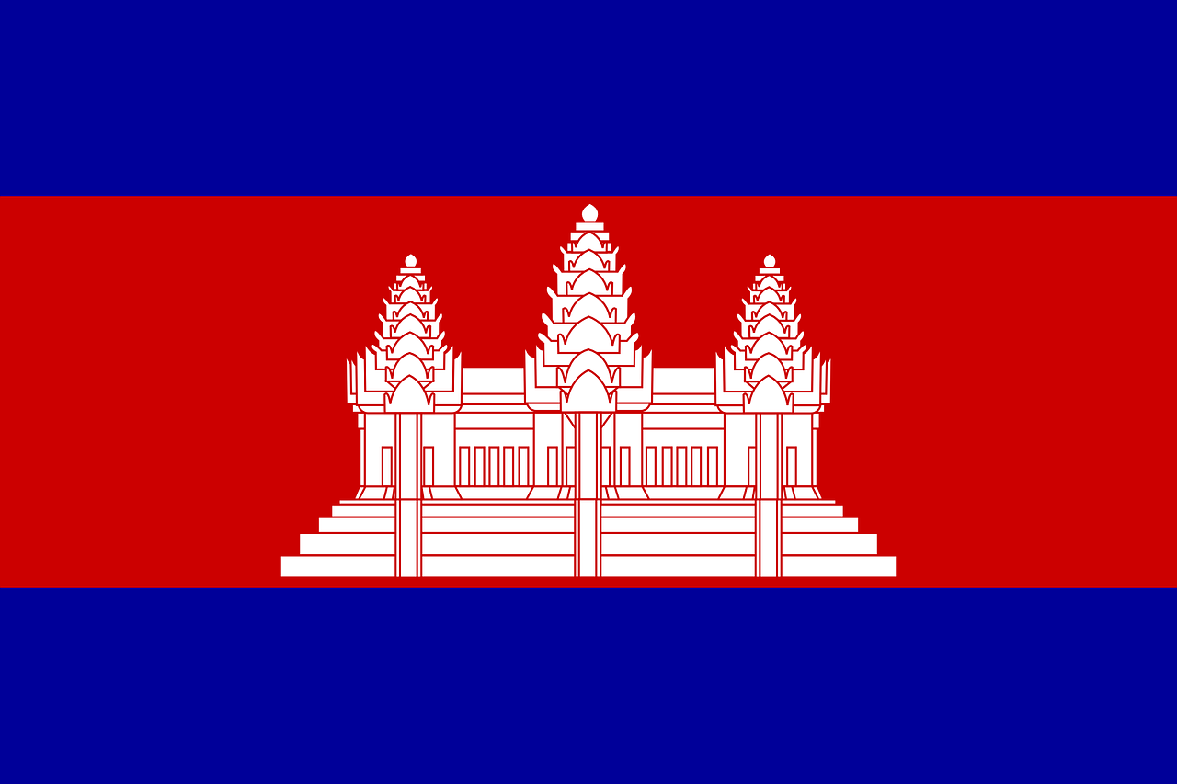
Introduction
One of the most well-known events in recent history is the Cambodian genocide
While some steps have been taken towards justice in Cambodia, the people deeply connected to the issues will be helped by implementing restorative justice principles through a truth and reconciliation commission

Slide 3
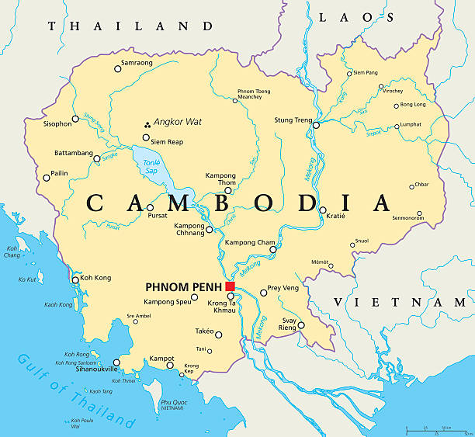
Historical Context
Between 1967 and 1999 there was nearly continual conflict in Cambodia
1967 to 1975 – Cambodian civil war
1975 to 1979 – Cambodian genocide
1979 to 1982 – Vietnam invaded and occupied Cambodia
1982 to 1989 – An alliance was formed, and there was fighting between various powers
1989 to 2000s – Vietnam leaves Cambodia, and after more political chaos, Cambodia begins to stabilize
Notes:
1967 – 1975: Cambodian civil war between pro-American government and Communist rebels.
It included bombings by the US in Cambodia due to Vietnamese fleeing to Cambodia
1975 – 1979: Cambodian Genocide, more than 2.5 million people died, nearly a quarter of the population at the time.
Pol Pot put to death anyone who disagreed with the government, had an education, or did not meet production standards.
The Khmer Rouge wanted a society of rice farmers
Everyone in the capital city was forced out of the city and into the countryside
1979 – 1982: Vietnam invaded and occupied the country.
Some progress was made towards recovery, but several small fighting forces funded by outside sources, like the United States, were fighting against the Communist Vietnamese rule.
1982 – 1989: An alliance was formed and a UN-backed government was established.
Lots of fighting between different groups
1989 – 2000s: Vietnam leaves Cambodia
Violent and chaotic political processes occur in an attempt to run a democratic government. Lots of corruption and even a coup happens.
The government gains more popularity due to the reinstallation of Buddhist practices and the creation of more opportunities and houses for Cambodians
The country begins to be more stabilized in the 2000s

Slide 4
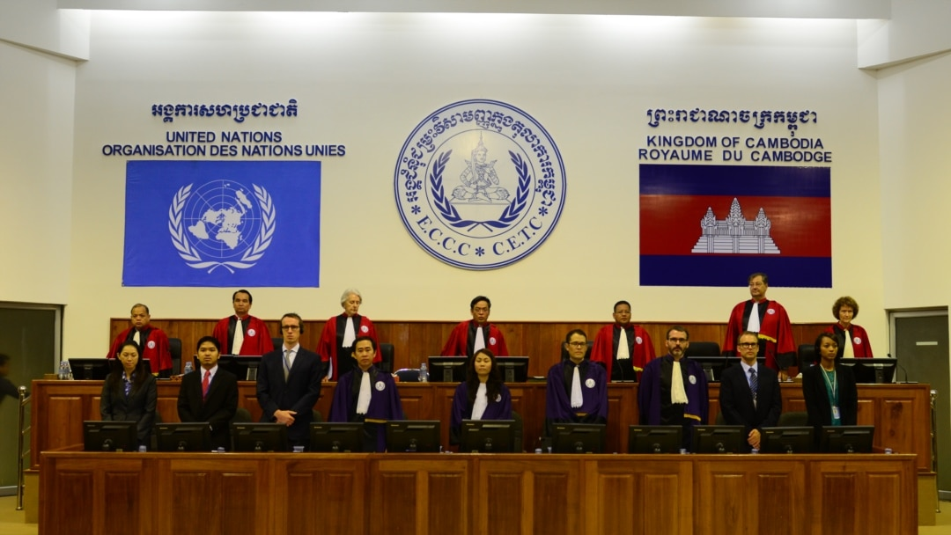
Attempts towards Justice and Reconciliation
A joint UN-Cambodian Tribunal was formed in 2003.
Many Khmer Rouge Leaders were tried in court, but only three have been sentenced to prison.
81.4% – Could not name a single reparation project
61.3% – Want a TRC established
There is still more to do!
Notes:
A joint UN-Cambodian Tribunal was formed in 2003.
Many Khmer Rouge Leaders were tried in court, but only three have been sentenced to prison.
Many died before being sentenced
The last sentence was in 2014
Study done in 2018:
81.4% - Could not name a single reparation project
Most Cambodians have not had a chance to share their experiences
80% of those who did share in the Tribunal said it was a positive experience and helped them to heal
61.3 – Want a TRC established
Establishing a TRC would allow the communities to heal in a more uniting way
There is still more to do!

Slide 5

Exploring the Potential of a Restorative Justice Practice through TRCs
TRCs are restorative justice-based alternatives to assist societies in confronting their past
They provide a voice for silenced victims
The Restorative Justice approach would deliver justice that is missing in Cambodia
Notes:
“Truth and reconciliation commissions have emerged as a restorative justice-based alternative to assist societies confront their past and are now considered a core transitional justice intervention” (Androff, 2013)
TRCs are adaptable and temporary bodies that are meant to guide healing and truth-seeking for a time.
They are adaptable in that they depend heavily on local traditions and contexts applied to the situation. They also provide a platform for the “silenced voices of victims” to be heard and recorded, which can bring relief to victims
After years of research are done, a TRC will publish its research and findings in one final report, which will serve to educate society on the atrocities and violations that have taken place.
The report will also have specific suggestions of what communities and nations can do to foster continued learning and reconciliation (Androff, 2013).
This restorative justice approach would deliver the justice that is missing in Cambodia.

Slide 6
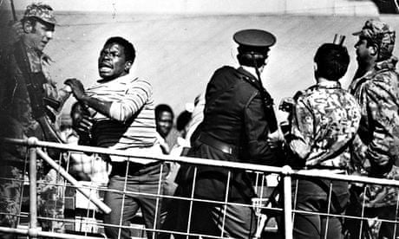
Exploring the Potential of a Restorative Justice Practice through TRCs
South Africa TRC is the most famous example
It inspired many other nations to adopt a similar practice, such as Greensboro, North Carolina, and Canada
The South Africa TRC included cultural principles, such as Ubuntu

Slide 7
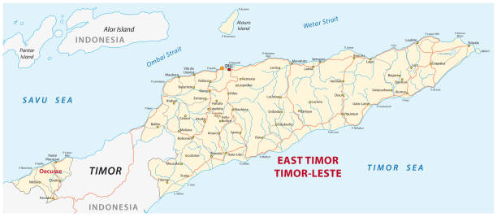
Exploring the Potential of a Restorative Justice Practice through TRCs
Timor-Leste is a unique example that gives valuable insights
They included a Community Reconciliation Process or CRP
The CRP allowed for more community-specific antidotes and healing
It included things offenders could do to reconcile with the community they offended
Notes:
Timor-Leste is close geographically. While they have different religions, similar principles can be applied
Timor-Leste was under Portuguese rule, and when it gained its independence, it only had nine days before Indonesia invaded and took over. With the more than twenty years of Indonesian occupation in Timor-Leste came mass killings, rapes, displaced populations, and famine
However, when it gained its independence in the late 1990s, it also launched a TRC.
This committee “fulfilled the restorative justice principle of restoring human dignity to victims by eliciting their stories and acknowledging their suffering through their testimony at public hearings and in their statements” (Androff, 2013).
They used a Community Reconciliation Process (CRP) to help fulfill their purpose.
The CRP allowed soldiers and other offenders to go to specific communities where these atrocities were committed and face their victims. This was mainly for more community-specific crimes.
These CRP meetings were very specific to the culture and focused on the individual villages and communities
Michael Wessells, in talking about community reconciliation in post-conflict reconstruction has said “An essential first step, one that required taking an anthropological perspective, was to understand how local people and the formerly recruited young people themselves understood the problem.” (Wessells, n.d.).
An important part of CRP is to understand the local context and culture and to understand how the CRP can benefit and adapt to them.

Slide 8
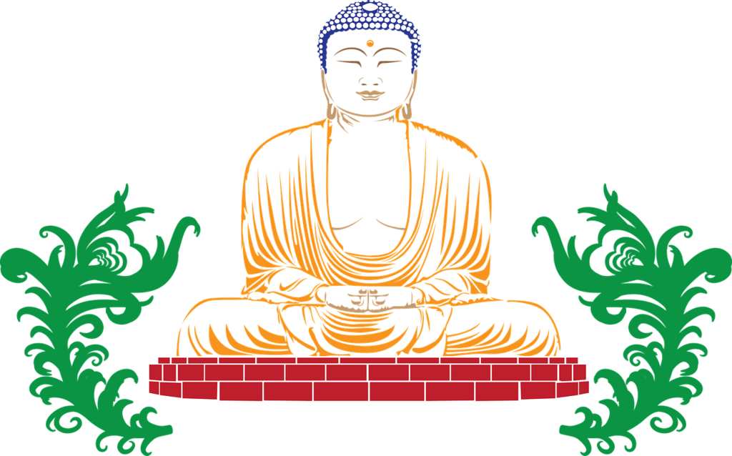
Applying Restorative Justice Practices to Cambodia
Implementing a TRC that includes a CRP would assist in healing and justice efforts.
It would be important to apply Buddhist principles to a Cambodian TRC
The Lion’s Roar Sutta
The Vinaya
Provide people with what they need and reform intention
Notes:
Rather than providing a blanket diagnosis of healing, the process will be more individualistic, which will foster relationships and communal growth.
David R. Loy, a scholar on Buddhist belief, theology, and tradition, has explained clearly what some of the perspectives of justice in Buddhism are. Loy first mentioned the Lion’s Roar Sutta, which teaches that “the solution is not to ‘crack down’ harshly with severe punishments but to provide for people’s basic need” (Loy, n.d.)
Provide all with their basic needs and let the amazing Cambodian people practice their peace principles to create a peaceful society
The Vinaya says that for a judicial system to truly be healing, it must shift from punishing guilt to reforming intention.

Slide 9
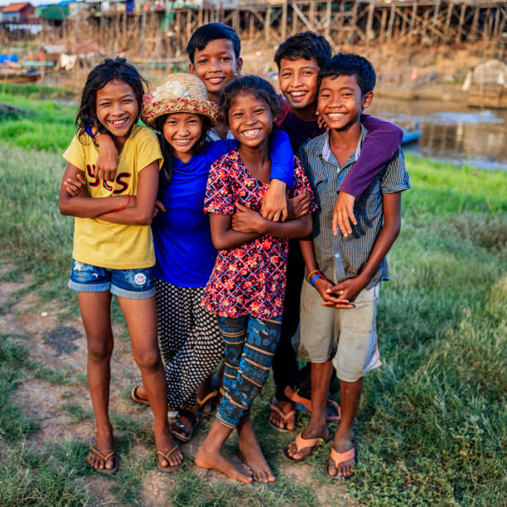
Applying Restorative Justice Practices to Cambodia
It is important to include the voices of the youth in these committees
Showing the youth the power of their shared and collective experiences, along with those that may have been affected, will make the youth agents of peace
It is also important to follow local customs and celebrations
Cultivate a culture of peace
Notes:
Michael Wessells has said, “Helping young people to become agents of peace is one of the best means of breaking intergenerational cycles of violence and enabling the transformation of a culture of war into a culture of peace” (Wessells, n.d).
Making them agents of peace will have a powerful effect on the community and could even prevent, to some degree, future conflicts.
A report on the Canadian TRC said, “Processes of renewing community responsibilities through feasts or gatherings are not necessarily available in the TRC structure. Additionally, rather than use the state-centred language of reconciliation, our focus is on family-centred, community resurgence, and restorying justice” (Corntassel et al., 2018).
Focusing on smaller units, such as communities and families, will allow local customs to be implemented, which creates a culture of healing and will help the progress of individuals.
Focus on cultivating cultures of peace.

Slide 10
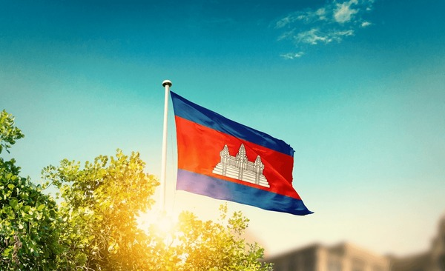
Conclusion
By applying the principles of Restorative Justice and Buddhism in a Truth and Reconciliation Meeting, many more Cambodians will be able to find peace and resolution from a conflict they are deeply connected to.

Slide 11
References
Chandler, P, D., Overton, & C, L. (2025, March 13). Cambodia | History, Map, flag, capital, population, Language, & Facts. Encyclopedia Britannica. https://www.britannica.com/place/Cambodia/Vietnamese-intervention
Corntassel, J., University of Victoria, ESC, Chrisjohn, R., Young, S., Michael Maraun, Aboriginal Healing Foundation, & Alfred, T. (2018). Indigenous storytelling, truth-telling, and community approaches to reconciliation.
Summers, L. (1972). The Cambodian Civil War. Current History, 63(376), 259–262. https://www.jstor.org/stable/45312769
Loy, D. R. (n.d.). Healing Justice: a Buddhist perspective.
van Wormer, K. S., & Walker, L. (Eds.) (2013). Restorative justice today: Practical applications. SAGE Publications, Inc., https://doi.org/10.4135/9781452244228
Wessells, M. W. (n.d.). Handbook on Building Cultures of Peace (J. De Rivera, Ed.). Springer. https://link.springer.com/content/pdf/10.1007/978-0-387-09575-2.pdf#page=352
Williams, T., Bernath, J., Tann, B., & Kum, S. (2018). Justice and reconciliation for the victims of the Khmer Rouge. In Report Brief. https://www.uni-marburg.de/de/konfliktforschung/dateien/drittmittelprojekte-dateien/tw-victimhood-policy-brief-en-2018.pdf
All photos are free/public stock images

